Slide 1


Docu-Vision
For
2024

Slide 2

Hello,
We are MS_Cube : Meghana, Sanjana, Shih-Hsuan, Santhosh
A team of Master’s students in Business Analytics dedicated to solving real-world challenges through innovative technology.

Slide 3
Overview
1. Problem Statement
2. Act 1: The Rise
3. Act 2: The Fall
4. Act 3: The Resurrection
5. Results

Slide 4
Problem Statement:
Unstructured document processing relies heavily on OCR accuracy, limited by its error-handling capabilities and longer processing times, hampering efficiency in financial operations.
This project aims to leverage multimodal Large Language Models to create a robust information extraction pipeline, bypassing OCR limitations and enhancing accuracy across various document formats.
Models: GPT-4o
Datasets:
Invoices – a Total of 50 documents with formats of .pdf, .jpg, .tiff, .jpeg
Articles of Incorporation – a total of 9 .pdf documents with a total of 21 pages
Notes:
Mention model and datasets with no.of documents
Aoi – mention no.of pages
Add prompt – system prompt, user prompt, conversion of images-inpout,output
Goals should be in problem statement

Slide 5
Act I : The Rise
Notes:
Research - Construct the pipeline, – APIs don’t support image files – convert to base64 – why? extracting text directly from documents rather than convert to text
Workflow diagram
How did we start? Initial prompt Vs. Best Prompt – normalization (Chain of Thought)
Invoice fields image
Json structure – list of dictionaries

Slide 6
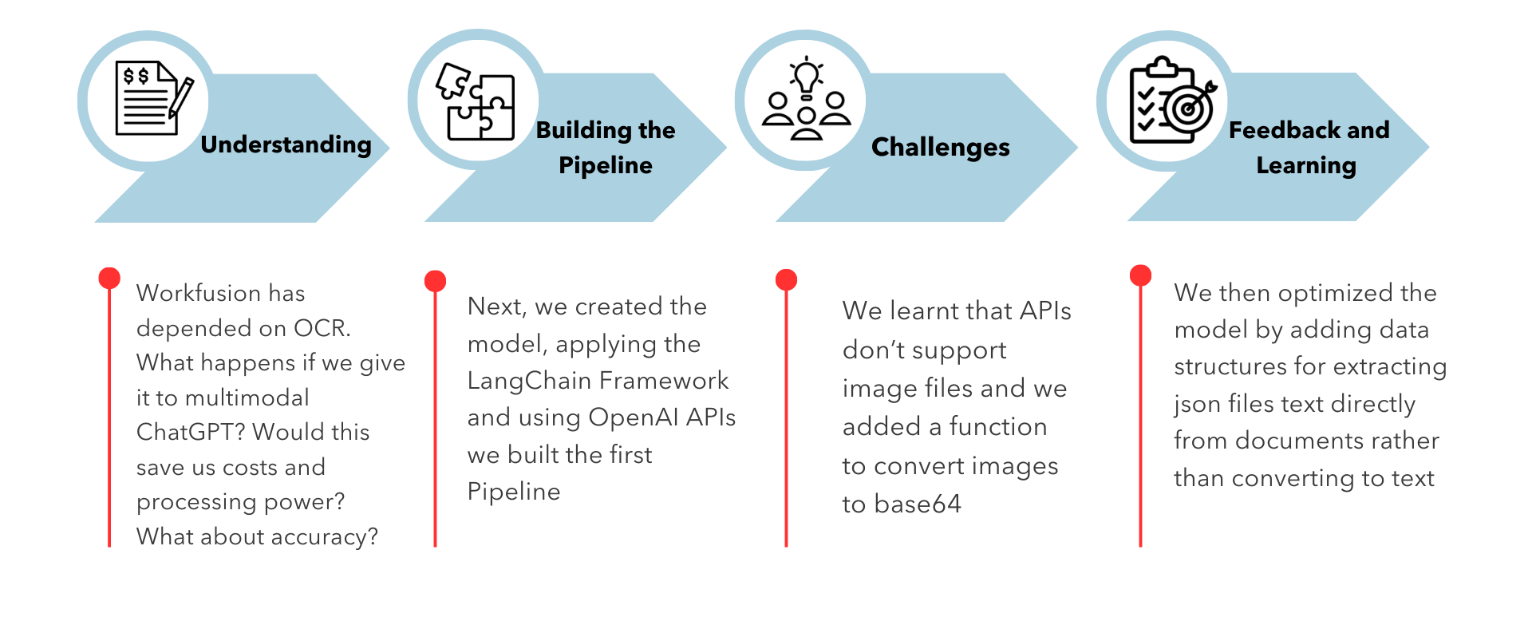
Research and Learnings

Slide 7
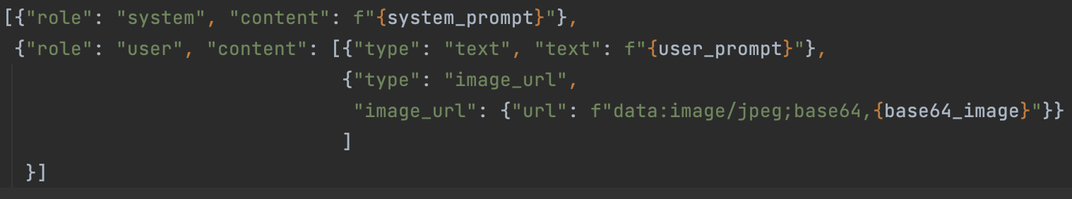
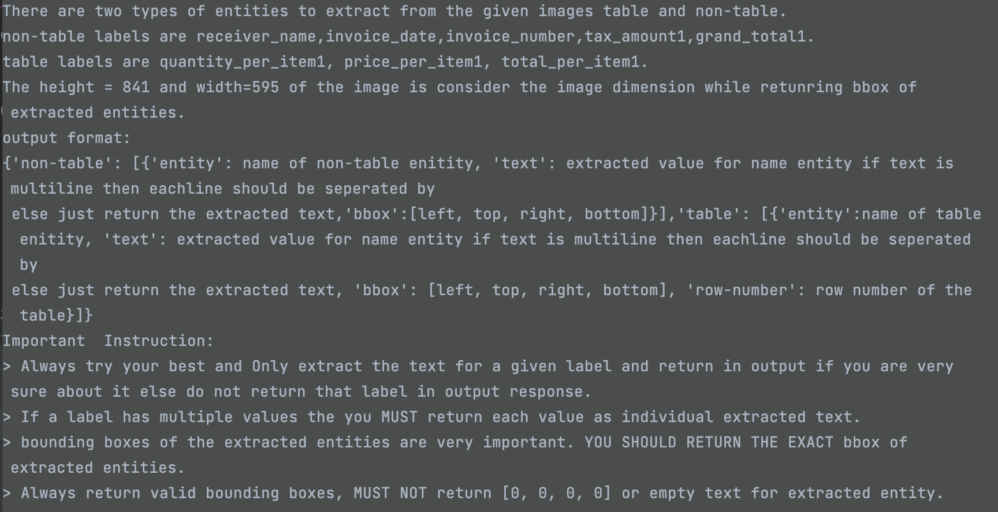
Prompt
Complete Prompt:
User Prompt:
System Prompt:
You are an advanced document information extraction model specializing in extracting structured information from invoices. ​Your goal is to extract specific given fields from an invoice image with its bounding boxes. Bounding boxes must be normalized from 0 to 1.
Notes:
What is the system prompt?
What is the user prompt?
What directions are we giving to the model? – why are we normalizing? – bringing the nearest bounding box to the text

Slide 8
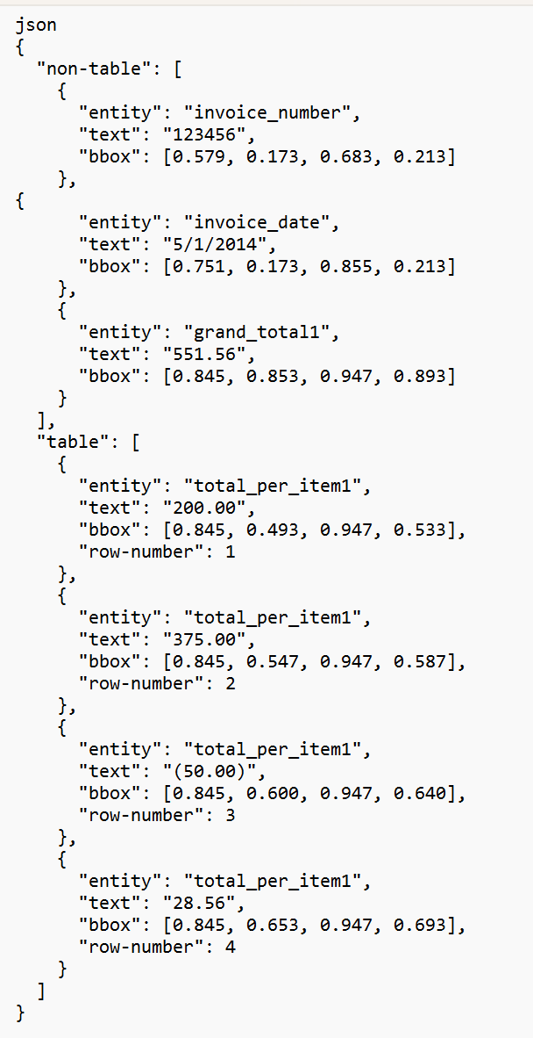
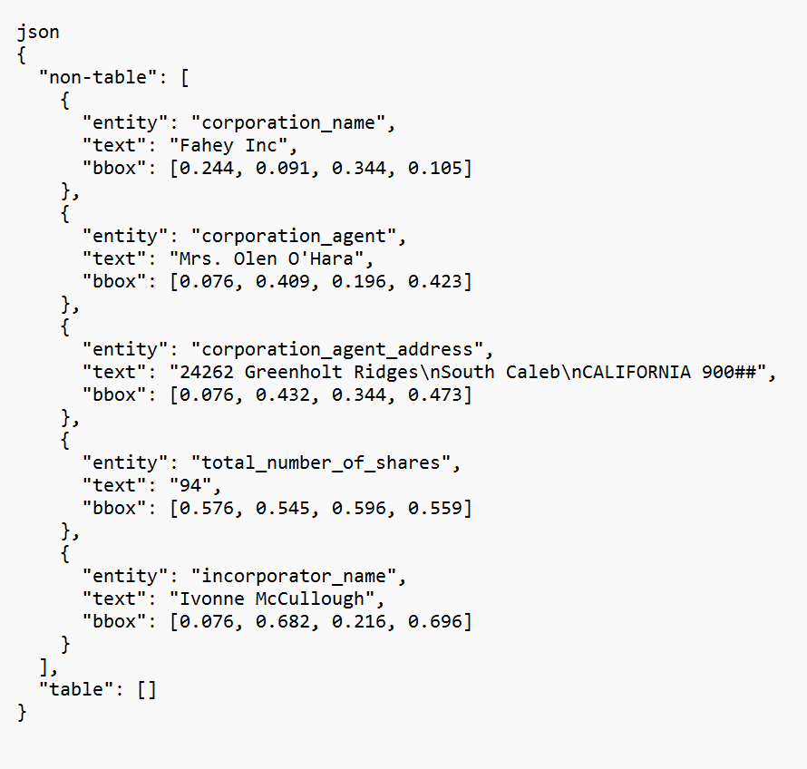
JSON Structure – List of Dictionaries
Invoice
Articles of Incorporation

Slide 9
Act II : The Fall
Notes:
Research on how to prompt, ask for normalization – why? – The reason is because that’s what the model has primarily been trained on
3 images ran through different prompts/runs, throwing different results each time
Image dimensions were experimented with all GPT models, and we tabulated the results - That concluded that GPT models are currently incapable of retaining pixel-level information
Ran another experiment on Normalization vs. top, left, bottom, right nomenclature
Some results achieved
Is OCR really dependable? Some labels where OCR didn’t capture some characters and examples of those.
About Approaches- why normalized bounding boxes and what were the prior issues ? – just one page - Extracted

Slide 10
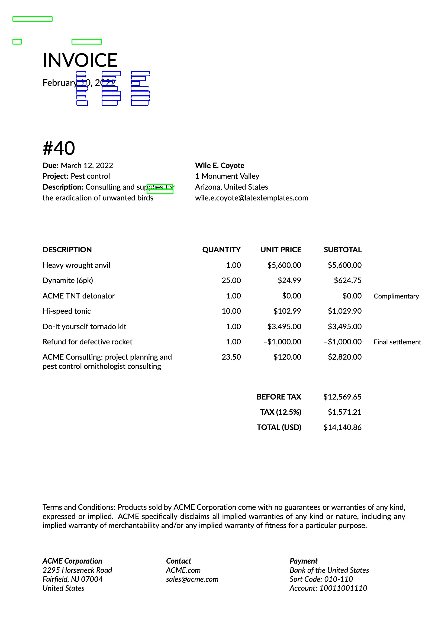
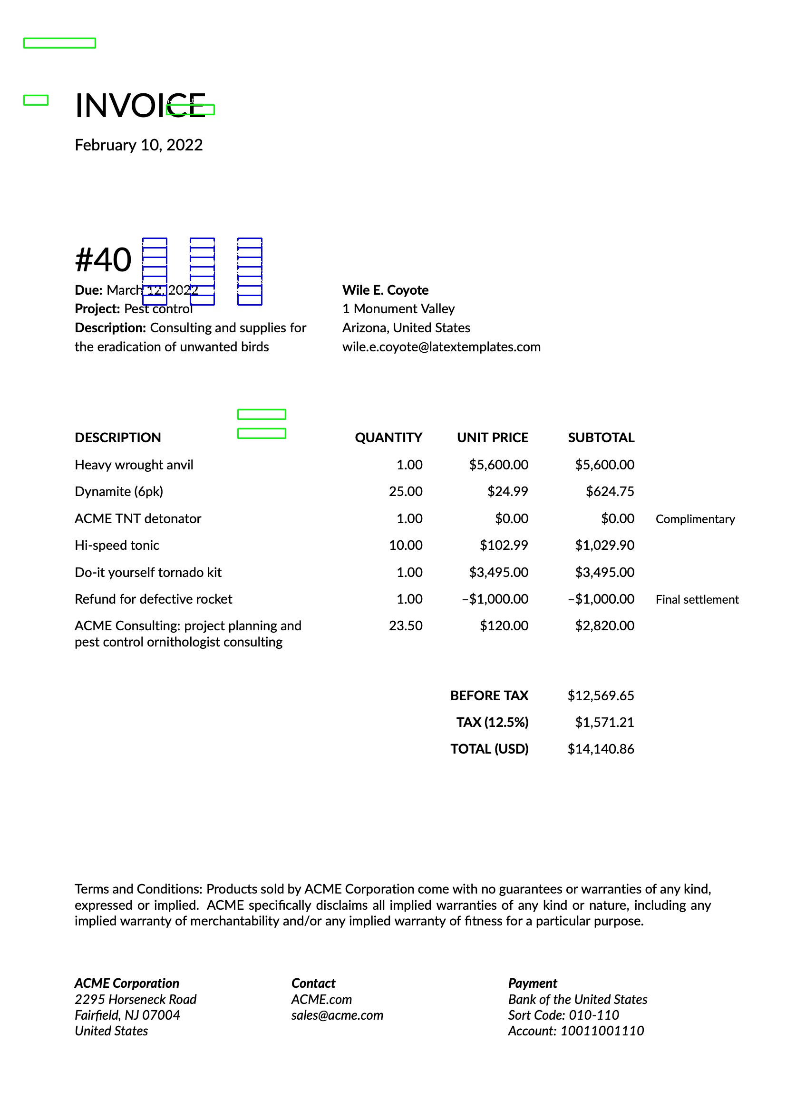
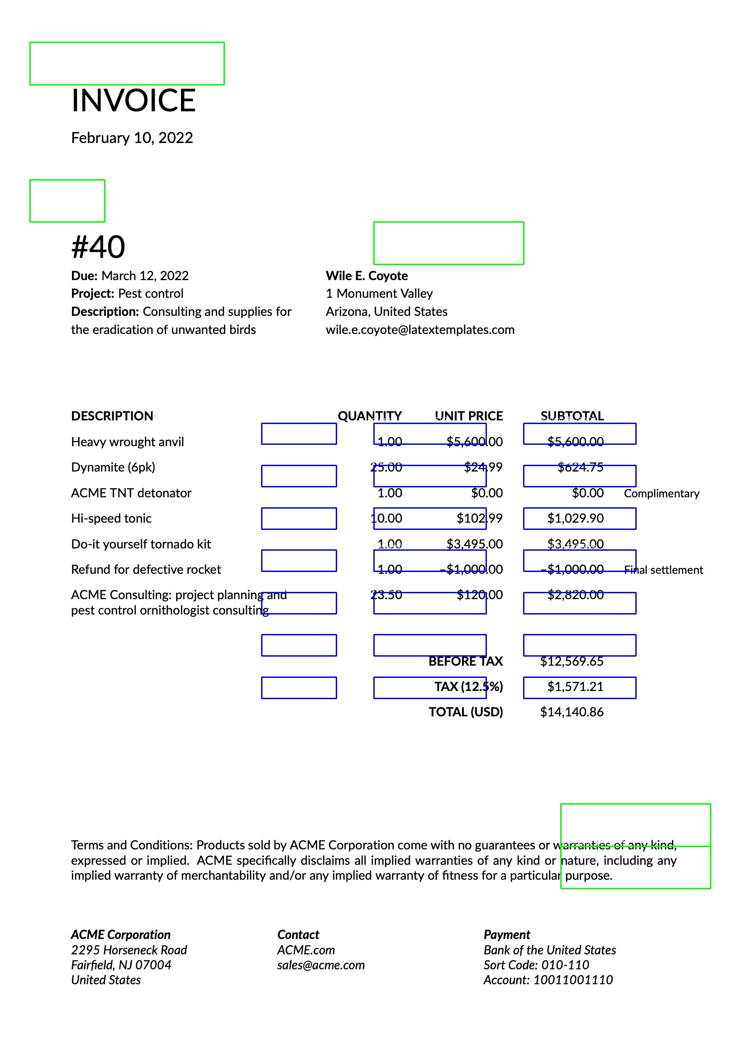
THE BOTTLE NECK........................
INCONSISTENT RESULTS!
x_min , y_min , x_max, y_max
Left, top, bottom, right
normalised left, top, bottom, right
Notes:
Improved Bounding boxes with normalization

Slide 11
Act III : The Resurrection
Notes:
New Workflow is the code-block diagram
Mention the key differences – add another slide for it – String matching logic and multi-line matching ---done
Explain the code logics ---DONE
Output images --DONE
Final Results and statistics for all datasets ---done
Comparison with the base-existing process and OCR/current results ---

Slide 12
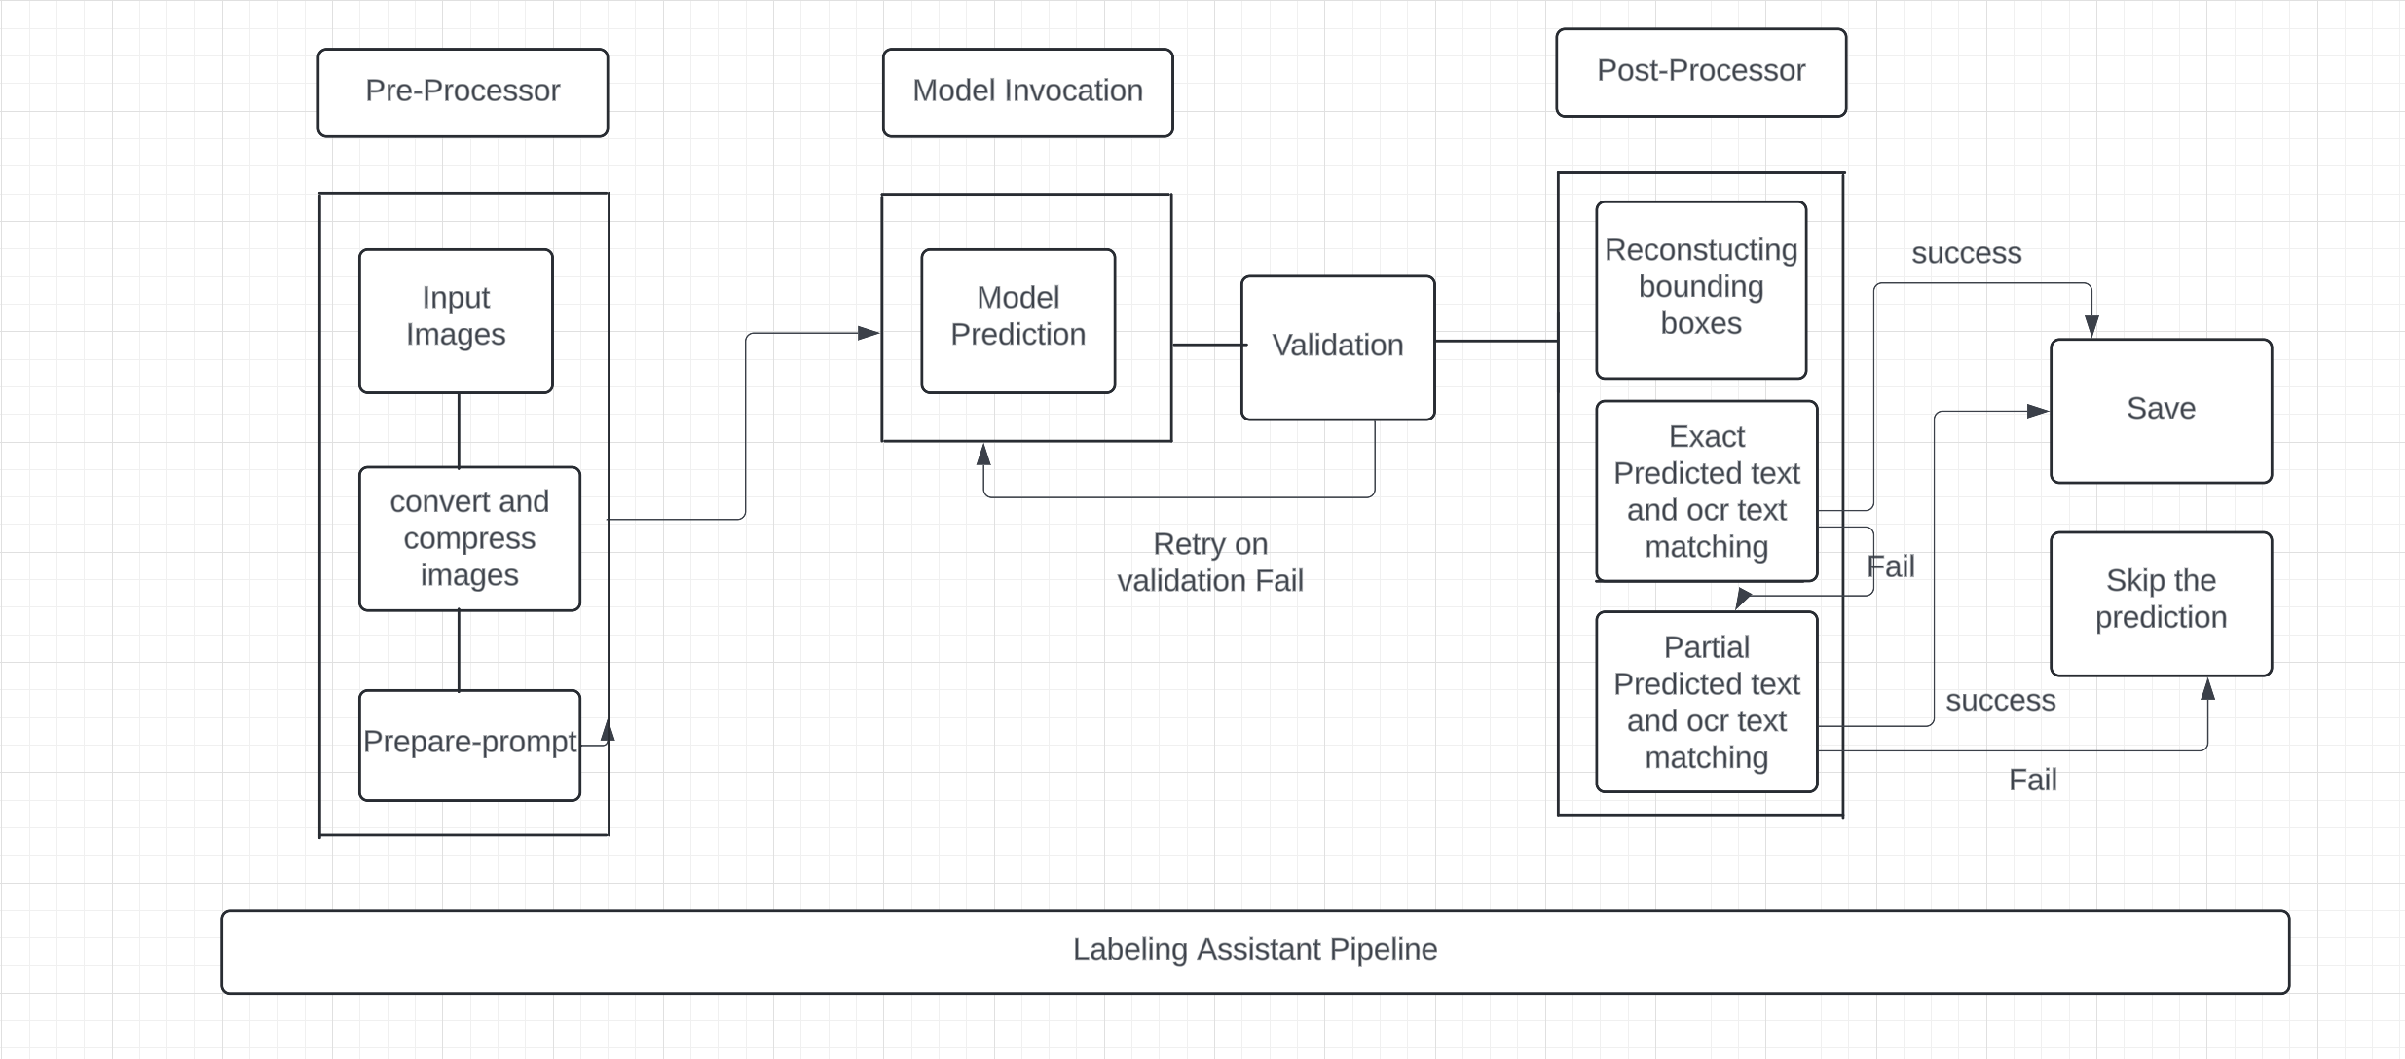
Workflow
Notes:
Workflow diagram

Slide 13
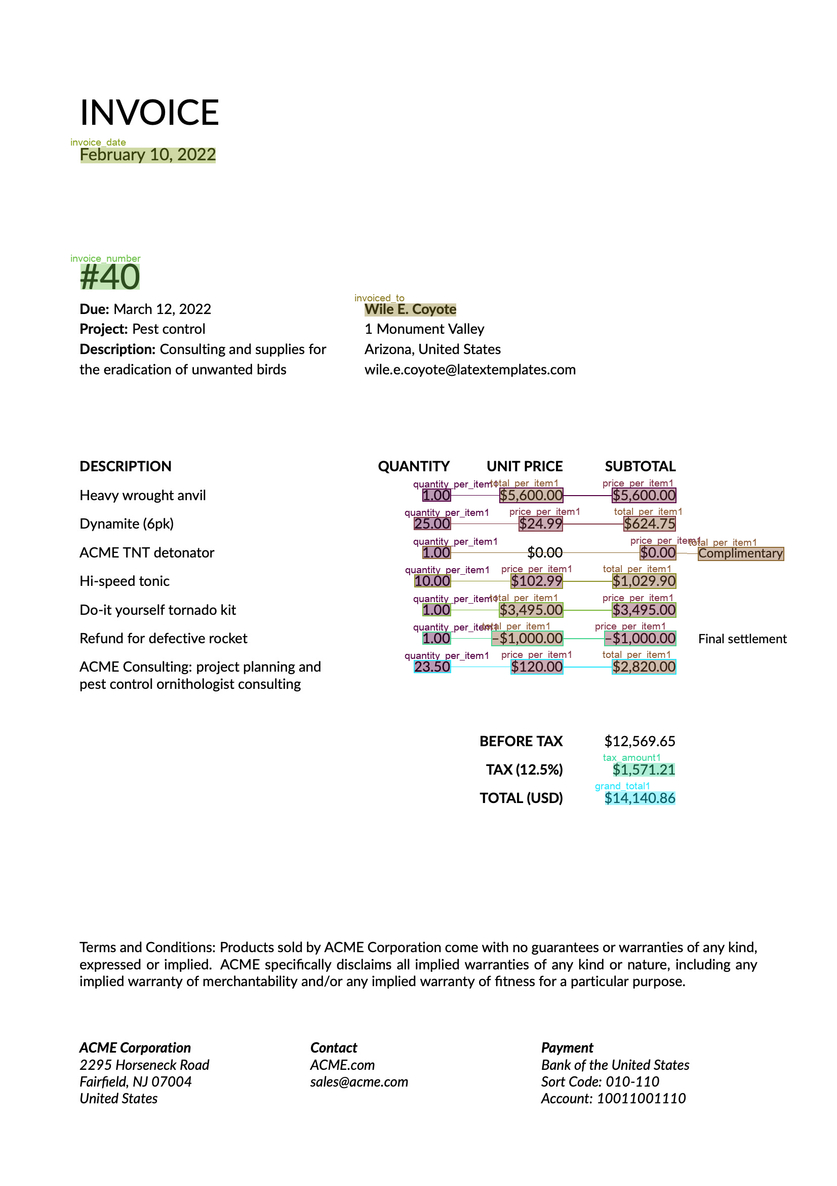
Results and Statistics

Slide 14
Invoice Per-field Statistics:
FIELD | PRECISION | RECALL | F1 | # of samples
invoice_date | 96% | 94% | 95% | 49
price_per_item | 91% | 90% | 91% | 140
quantity_per_item | 91% | 88% | 90% | 145
invoice_number | 82% | 89% | 85% | 44
total_per_item | 78% | 82% | 80% | 130
grand_total | 69% | 67% | 68% | 48
tax_amount | 60% | 54% | 57% | 28
invoiced_to | 45% | 43% | 44% | 47
AVERAGE | 77% | 76% | 76%
CONCLUSION:​
All the green highlighted fields are the fields that have higher accuracies while red highlighted fields need improvement.
Fields such as tax_amount and invoiced_to need to be improved.
The model demonstrates strong performance with an F1 score of 0.80, balancing high precision (0.81) and solid recall (0.79) in extracting structured information from invoices across 370 ground truth relationships. While reliable, the slight gap between precision and recall suggests opportunities to improve detection of subtle or missed relationships.
Invoice Relational Statistics:​
Doc Type | PRECISION | RECALL | F1 | Support
Invoice | 81% | 79% | 80% | 370

Slide 15
Invoice Per-field Statistics Comparison with BaseLine:
FIELD | Baseline F1(A) | Current F1(B) | B-A | # of samples
grand_total | 43% | 68% | +25% | 48
price_per_item | 81% | 91% | +10% | 140
invoice_number | 77% | 85% | +8% | 44
tax_amount | 49% | 57% | +8% | 28
quantity_per_item | 85% | 90% | +5% | 145
invoice_date | 92% | 95% | +3% | 49
total_per_item | 77% | 80% | +3% | 130
invoiced_to | 50% | 44% | -6% | 47
Average | 69% | 76% | +7%
CONCLUSION:
On average there is a 7% improvement in per-field statistics for Invoice dataset.
However, field like invoiced_to has a significant drop while fields such as grand_total has significant improvement.
These can be because of failure of reconstruction of bounding boxes due to OCR errors.
On average, there is a 3% improvement in relational statistics for Invoice dataset.
Invoice Relational Statistics Comparison with BaseLine:​
Doc Type | Baseline F1(A) | Current F1(B) | B-A | Support
Invoice | 77% | 80% | +3% | 370

Slide 16
Articles of Incorporation (AOI) Per-field Statistics:
FIELDS | PRECISION | RECALL | F1 | # of samples
total_number_of_shares | 100% | 100% | 100% | 5
incorporator_name | 81% | 83% | 82% | 10
corporation_name | 70% | 78% | 74% | 9
corporation_agent | 66% | 70% | 68% | 10
date_of_signature | 65% | 60% | 62% | 5
shareholder_names | 58% | 54% | 56% | 13
period_of_corporation_duration | 43% | 67% | 52% | 3
corporation_address | 44% | 53% | 48% | 5
corporation_agent_address | 21% | 33% | 26% | 6
incorporator_address1 | 17% | 25% | 20% | 4
AVERAGE | 59% | 59% | 59%
CONCLUSION:​
All the fields in the green are doing considerably well, while red highlighted fields need to be improved.
Long fields like addresses are mostly having low scores.

Slide 17
AOI Statistics Comparison with BaseLine:
Fields | Baseline F1 (A) | Current F1 (B) | B - A | # of samples
shareholder_names | 27% | 56% | +29% | 13
date_of_signature | 39% | 62% | +23% | 5
total_number_of_shares | 83% | 100% | +17% | 5
period_of_corporation_duration | 40% | 52% | +12% | 3
corporation_agent | 63% | 68% | +5% | 10
incorporator_address1 | 22% | 20% | -2% | 4
incorporator_name | 84% | 82% | -2% | 10
corporation_name | 100% | 74% | -26% | 9
corporation_agent_address | 55% | 26% | -29% | 6
corporation_address | 80% | 48% | -32% | 5
AVERAGE | 59% | 59% | +0%
CONCLUSION:​
On average there is no statistics change in AOI dataset.
However, long texts like addresses mostly have significant drops with new approach while some fields like shareholder_names, date_of_signature and total_number_of_shares has significant improvements.
These can be because of failure of reconstruction of bounding boxes due to OCR errors.
RAG applied for baseline to avoid splitting pages which can be the reason to get incorrect prediction because of losing information. We can try to send two page at a same time to get better results in current approach, required some research.

Slide 18
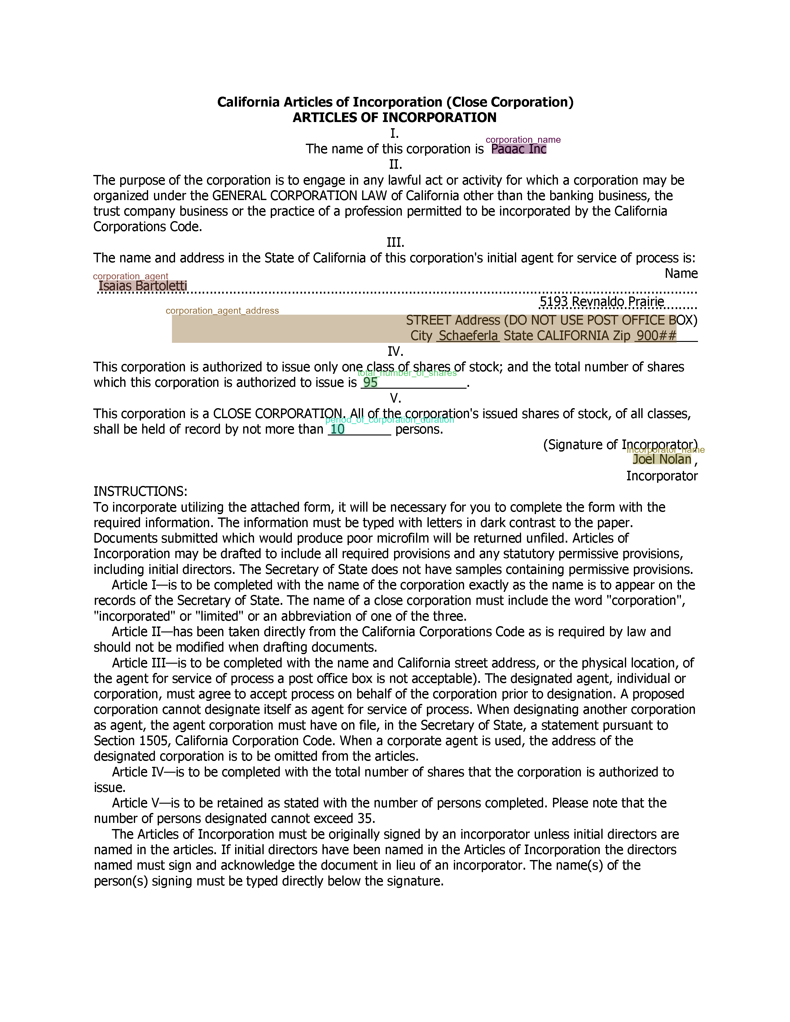
Error Analysis
GPT often corrects or reinterprets content, while the golds has the output text as is, without adjustments. ( For corporation_agent_address)
Both OCR and GPT occasionally fail to capture text accurately, especially when parts of the text are cut or incomplete. (For corporation_name)

Slide 19
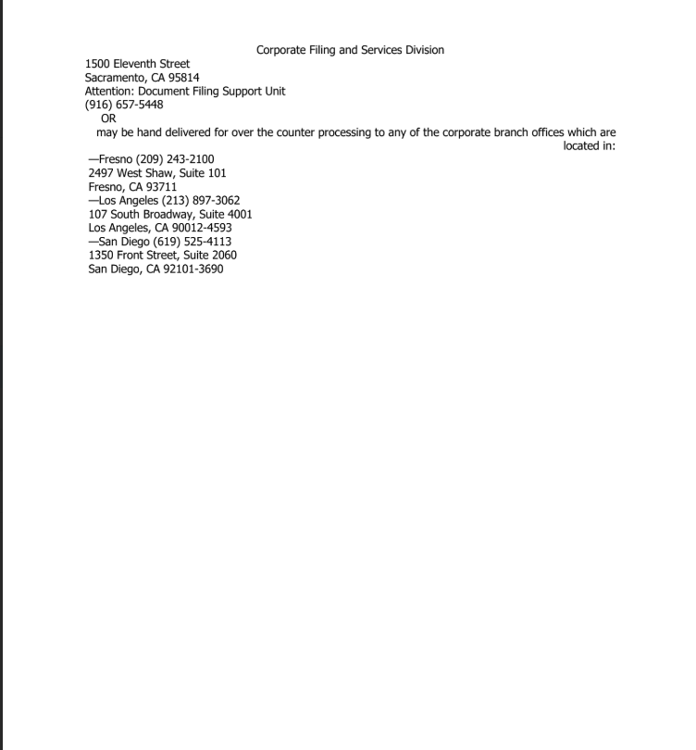
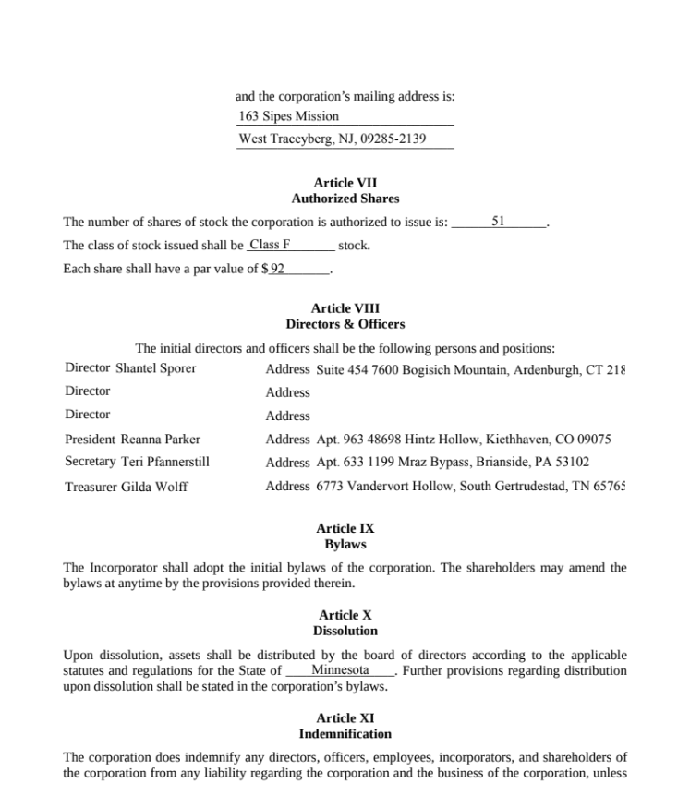
Error Analysis
Incorrect prediction as we are passing page by page which can be a reason to lose some contextual Information.
The gold label (sometimes) does not contain corporation_address sometimes and GPT tends to interpret it from the document. OCR may need tags when addresses are unclear.

Slide 20
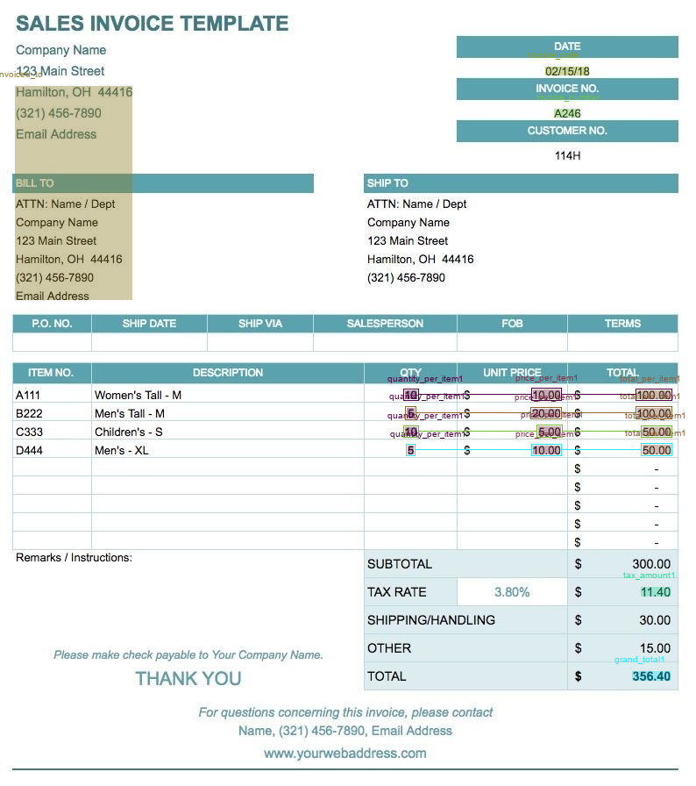
Error Analysis
Some Considerations Based on Observation:
OCR and GPT limitations: Both have issues with text extraction accuracy.
Clear address formatting: Improves OCR and GPT performance.
Use of tags: Helps OCR capture data when addresses are unclear.
Proximity of symbols: Ensure $ symbol is close to its field for GPT accuracy.
Regular validation: Ensures better data accuracy from both OCR and GPT.
GPT may capture the address from the invoiced_to field ,if it's placed below the name, and sometimes fails to capture the $ symbol if it's too far from the field.

Slide 21
Cost Analysis
 | Baseline |  |  | Current
Datasets | Input Cost | Output Cost | Inference Time | Output Cost | Inference Time
Invoices | $ 0.22 | $ 0.22 | 9 sec /call | $ 0.35 | 10 sec /call
(50 Pages)
AOI | $ 0.3 | $ 0.03 | 8 sec /call | $ 0.04 | 6 sec / call
(21 Pages)
Unit Price : $2.50 / 1 M input Tokens
$10.00 / 1 M Output Tokens
**Note: OpenAI multimodal calculates input cost based on input tokens, image size, and resolution. The image tokenizer most likely has not been published yet; the unit price has been provided for price estimation.
Conclusion: The cost of RAG has not been added for baseline cost analysis. The output cost difference is not significant between both approaches but we may save some cost for input since we are sending images instead of OCR texts to model but need some further research on OpenAI image to token calculation.
Notes:
A table containing costs for both datasets
Calculate the number of tokens for input
Number of tokens for output.
Inference time, Speed per datasets,

Slide 22
Conclusion:
Information and relation extraction with a multimodal model can be a potential option to eliminate OCR cost and OCR-related errors. It does have similar statistics.
Unfortunately, at this moment, OCR has been used since the model does not predict accurate bounding boxes, and OCR text matching has been used to reconstruct the bounding boxes, which is essential for information and relation extraction.
Potentially minimizing cost by sending image instead of huge number of OCR tokens and RAG to retrieve relevant context for model input in previous labeling assistant pipeline.
Next Steps:
Improve prompt or extraction logic to get a better model score.
Try different vendors with multimodal models like (OpenAI o1) to improve the results.
Test different multimodal models to find which ones give us the correct bounding boxes.
Few-shot Learning can be an option (needed some research)
Leverage Open-Source Models for better control over contextual understanding of the processing document

Slide 23
Thank you

